Slide 1
MECH 5970/6970
Lectures on Vision-based Navigation and Guidance
Sridhar Lakshmanan
Electrical & Computer Engineering
University of Michigan-Dearborn
Email: Lakshman@umich.edu

Slide 2
Why vision-based navigation?
Navigation in GPS-denied environments
Unintentional – e.g., ionospheric, buildings, wide-band interference
Intentional – e.g., jamming, spoofing, damage to satellites/relay-stations
Indoor, Underwater, Tunnels, …
Navigation in poor INS sensor performance – bias, drift, scaling, …

Slide 3
Fundamentals of vision-based navigation
Identify fixed points in the world over two successive image frames
Correspondence problem
Estimate the camera’s translation and rotation from these points
Inverse problem

Slide 4
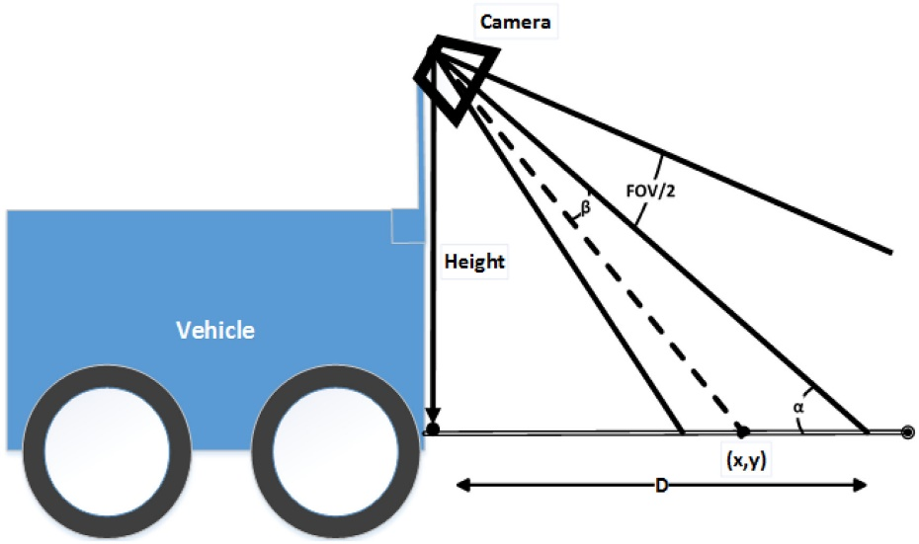
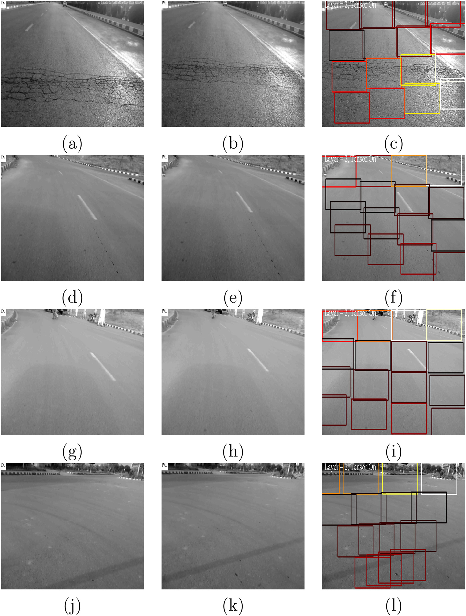
Correspondence problem

Slide 5
3-steps to solving correspondence
Find interest points in both image
Corners, blobs, T-junctions
Needs to be repeatable – under different viewing conditions
Find descriptor for interest points
Distinct feature vector
Robust to noise, detection errors, geometric/photometric distortions
Match descriptors between the two images
Distance-based: Euclidean, Mahalanobis, …
Compromise needed between feature vector dimension, distinctness, robustness and matching complexity

Slide 6
Finding interest points
Need a method for detecting all types interest points and at any scale
Scale-space representation of I
Image
Gaussian kernel →
Width determined by σ →
Larger σ implies more smoothing of I
Scale-normalized representation of I

Slide 7
Extrema of D → point of interest
(x,y,σ) is point of interest if it is a DOG extrema
Increasing scale → decreasing image detail

Slide 8
Matlab examples
Gaussian pyramid
Difference of Gaussian Pyramid
Interest point detector

Slide 9


Descriptor of interest point
For each interest point (x*,y*,σ*), in a spatial window around (x*,y*), compute gradient magnitude and direction using the Gaussian smoothed image L(.,.) corresponding to σ*
$$\hat{θ}\left(x,y\right)= θ\left(x,y\right)−θ(x\text{∗},y\text{∗})$$
H₁₁(x*,y*)
H₁₂(x*,y*)
H₂₁(x*,y*)
H₂₂(x*,y*)
Interest point descriptor based on 2x2 histograms of
$\hat{θ}\left(x,y\right)$’s

Slide 10
Matching of interest points
Minimum Euclidean distance:
For each interest point (x*,y*) at t₀, find ${argmin}_{α,β}$ $\sum_{i,j}{{\left\|H_{i,j}^{t_{0}}(x\text{∗},y\text{∗}) −H_{i,j}^{t_{1}}(α,β)\right\|}^{2}}$, where the minimum is only over the interest points (α,β) at t₁.
References:
(Correspondence Problem)
T. Lindberg, “Feature Detection with Automatic Scale Selection,” Int. J. of Computer Vision, 1998
D.G. Lowe, “Distinctive Image Features from Scale-Invariant Keypoints,” INTERNATIONAL JOURNAL OF COMPUTER VISION, 2004
H. Bay, et. al., “SURF: Speeded Up Robust Features,” Journal Computer Vision and Image Understanding, 2008
(Inverse Problem)
M.K. Kaiser, et. al., “Vision-Based Estimation for Guidance, Navigation, and Control of an Aerial Vehicle,” IEEE TRANSACTIONS ON AEROSPACE AND ELECTRONIC SYSTEMS, 2010
(Building Rome from 2 million Flickr images in a day)
https://grail.cs.washington.edu/rome/

Slide 11
Matlab examples
Feature extractor
Feature matching

Slide 12
Homework (Due 9/27/2019)
Problem 1
Consider the ‘detectSURFFeatures’ call. By changing the ‘MetricThreshold’ input argument, one can generate more/less points of interest. Plot number of detected features vs MetricThreshold value
Problem 2
Consider the ‘matchFeatures’ call -
by changing the ‘MatchThreshold’ input argument, one can generate more/less matches between the images. Plot number of matched features vs MatchThreshold value
By changing the ‘MaxRatio’ input argument, one can also can generate more/less matches between the images. Plot number of matched features vs MaxRatio value
Problem 3
Consider the two images ‘reference_map.jpg’ and ‘‘img_132.png’. Optimally select all the input parameters in the detectSURFFeatures and matchFeatures calls, so that at least 20 interest points are matched between them
Problem 4 (Extra credit)
Repeat Problem 3 for ‘reference_map.jpg’ and ‘test-image.jpg’

